Slide 1

Top down platforming bomb
Camron Oakeson

Slide 2
Game pitch
It is a top down platforming game. You play as a bomb who can’t explode! You use other fellow bombs to propel you to new locations. They have a short fuse so you have to position yourself before they explode and if you don’t you may just die.

Slide 3
Game mechanics
Jumping- via enemies
Walking- It’ll be a slower walk but you can turn a lot better walking
Running- You’ll be able to move fast but not turn as well.
Fall to your death
Moving platforms
Jump pads
Swinging obstacles

Slide 4
Enemies
Just a simple bombomb type character who walks up and explodes but they are also used to move you vertically.
Trap doors & walls
Swinging hammers or axes
Hard platforming

Slide 5
Camera
It’ll be a mixture between Link’s awakening, super Mario 3d world, and Captain toads treasure tracker

Slide 6
Level Design
A cross between Fall guys obstacle course and Link’s awakening temples
Wipeout has some good level design
It will use camera angle as a tool for puzzles like Captain toad’s treasure tracker

Slide 7
Video links to game examples
Super Mario 3d world level 1-1- I like the locked down camera in most of this game. It’ll need to be adjusted and locked down a little more. (0:20 – 1:00)
https://www.youtube.com/watch?v=0_k_UeDVuao
Link’s Awakening turtle shrine – I like the vertical puzzle demonstration for this camera view (20:00 – 20:53, 30:25 – 31:30)
https://www.youtube.com/watch?v=1yq-dezuXJg
A link between world’s wind shrine – Another great use of vertical layers. (4:30 – 7:00)
https://www.youtube.com/watch?v=QcTsIMelezA
Mario 64: Bomb omb battlefield- The idea for the enemy but using the bombs to move around a bit more (0:35 – 2:30)
https://www.youtube.com/watch?v=mHBfzdUC2EU

Slide 8
Video Links pt.2
Wipeout obstacle course- More great examples of obstacle course design (1:20 – 5:00)
https://www.youtube.com/watch?v=MqGh1sTpZPg
Wipeout obstacle course002- obstacle course design
https://www.youtube.com/watch?v=L6xyKDYsanQ
Crash Bandicoot bridge level - Good example of fixed camera with 3d platforming (9:32 – 15:00)
https://www.youtube.com/watch?v=xpIUkUd1MqE

Slide 9
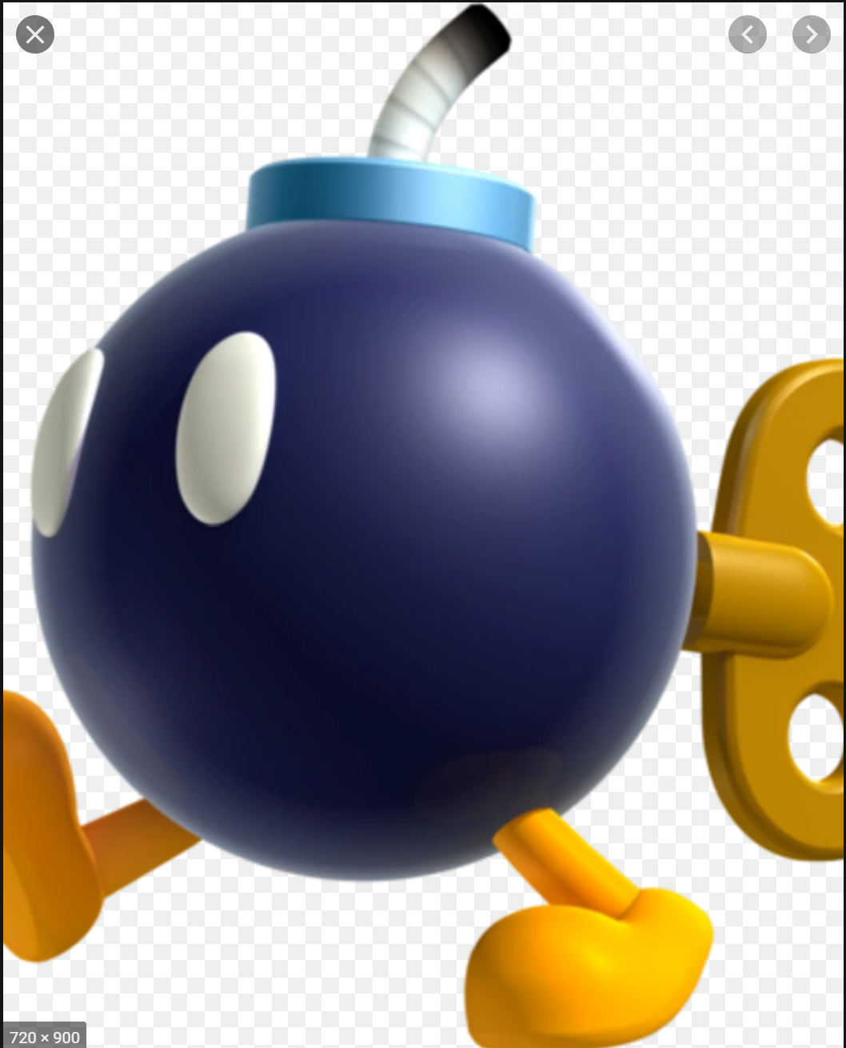

Pictures: Character design

Slide 10
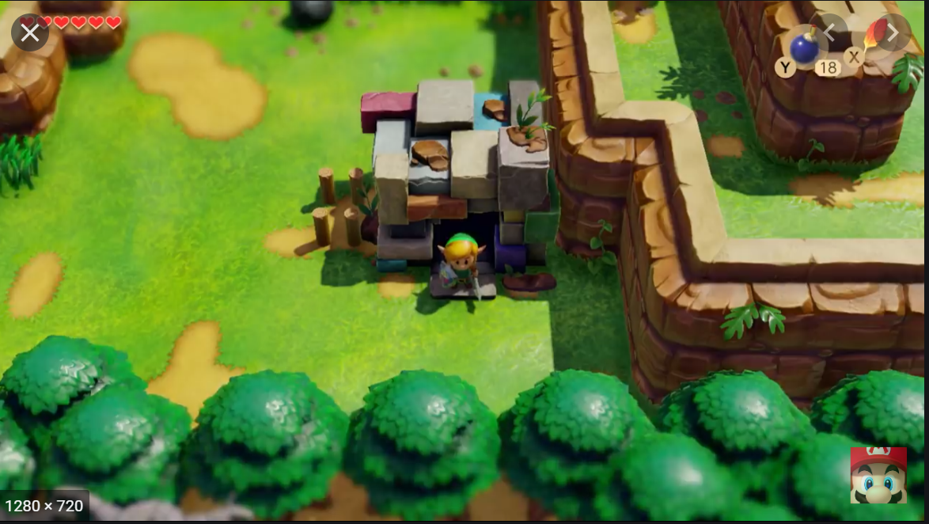
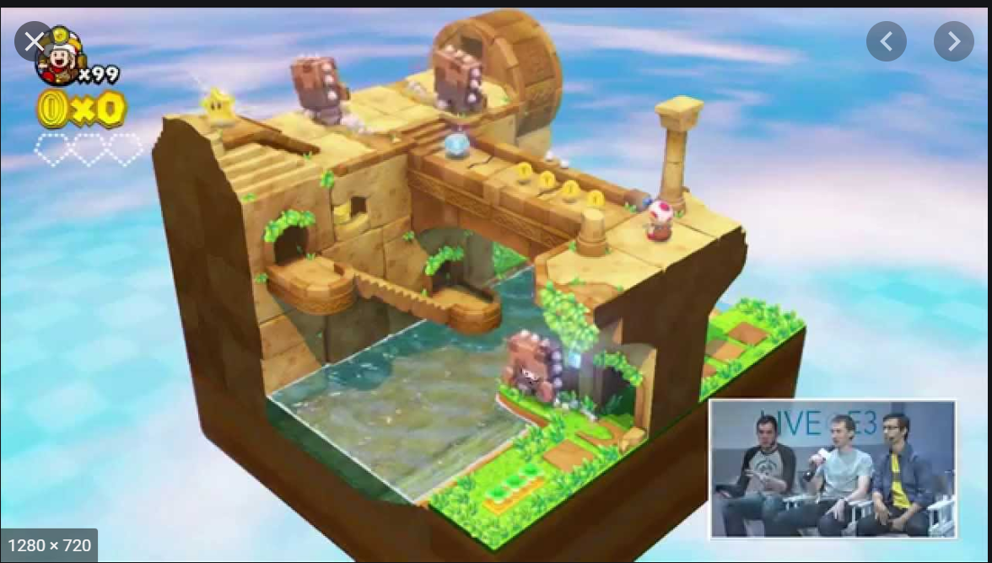
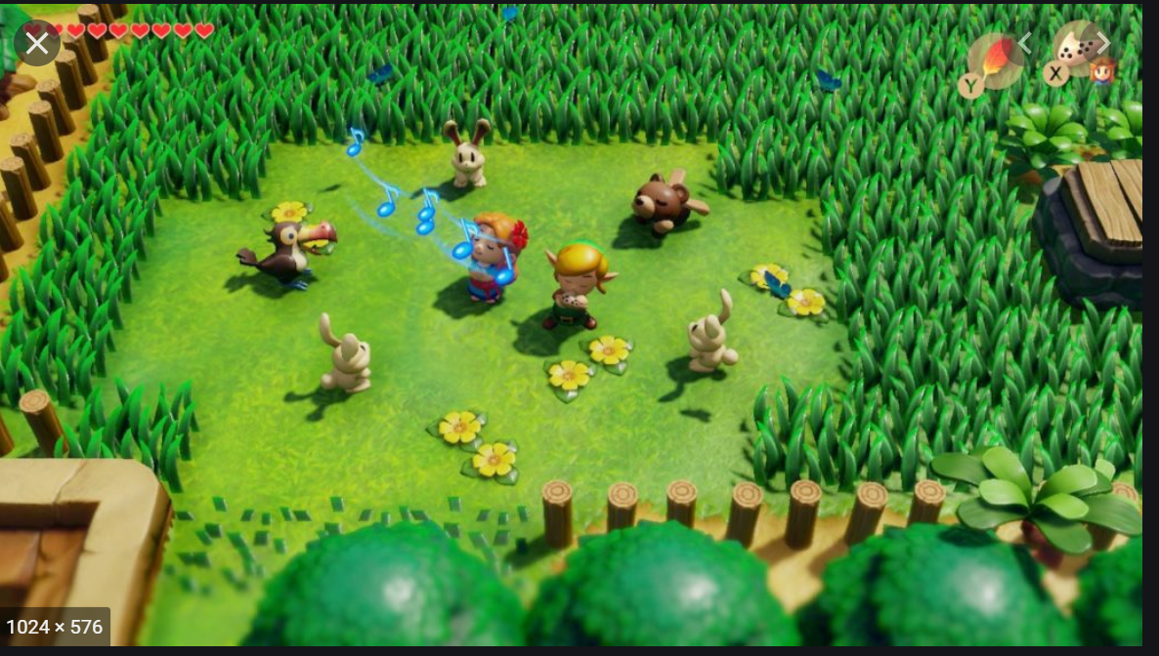
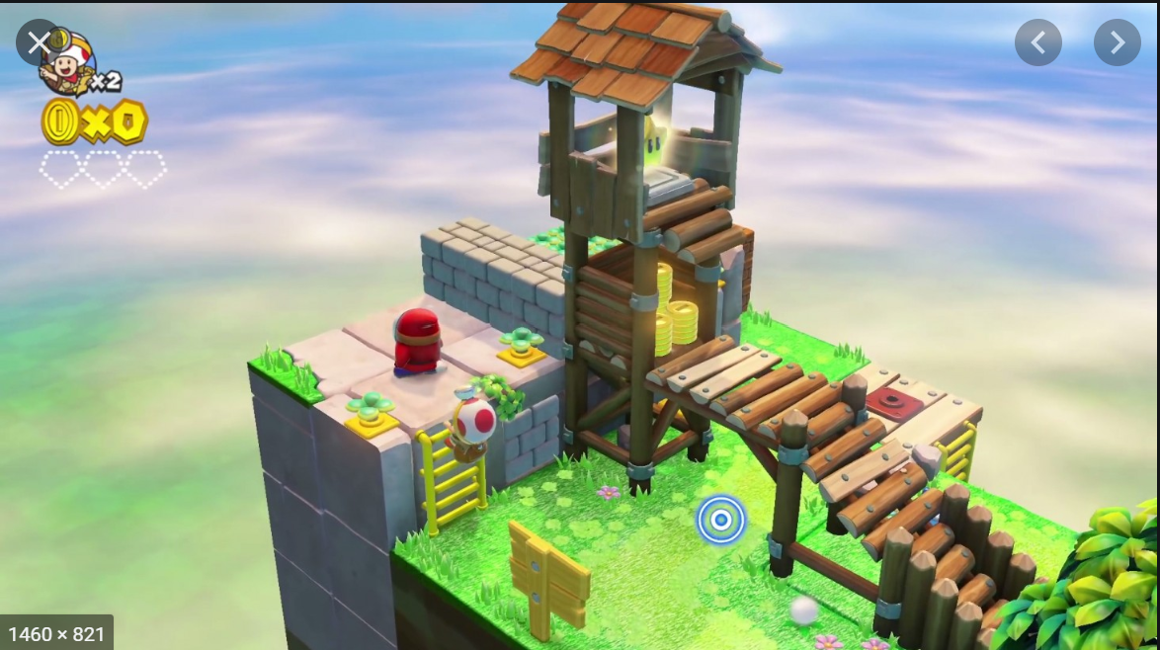
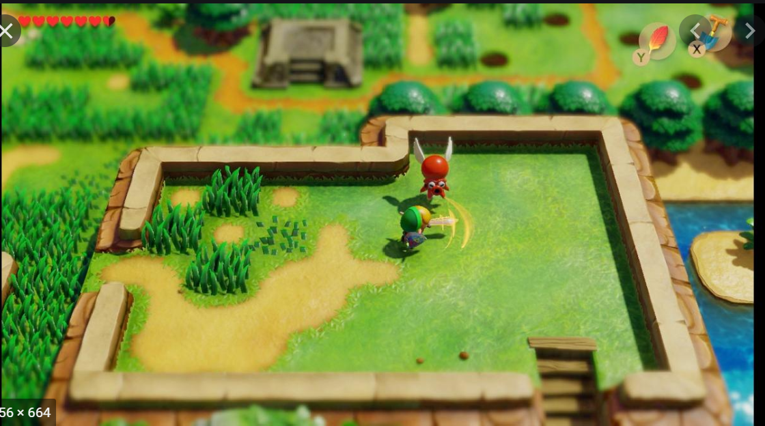
Pictures: Camera Angles

Slide 11
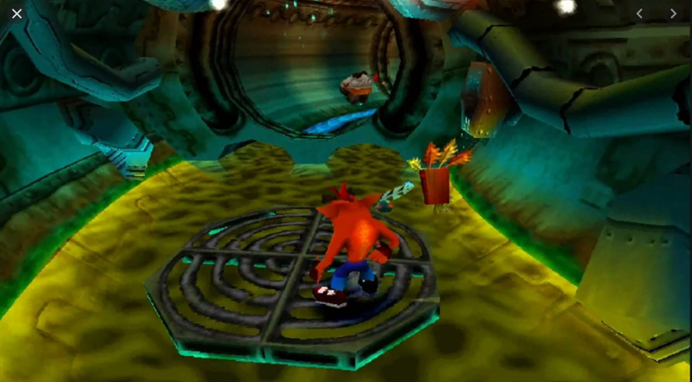
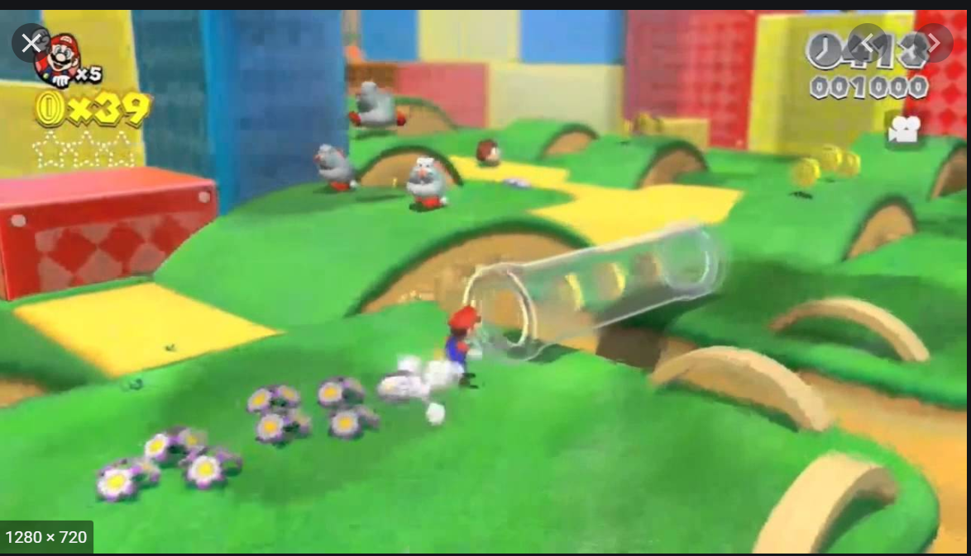
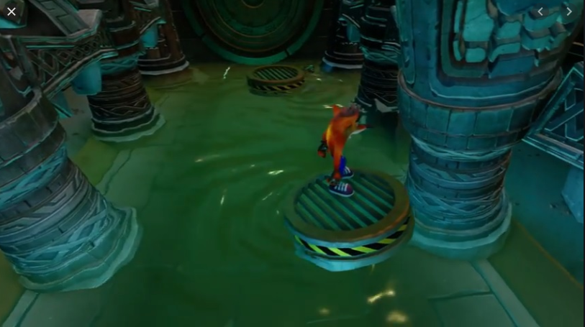
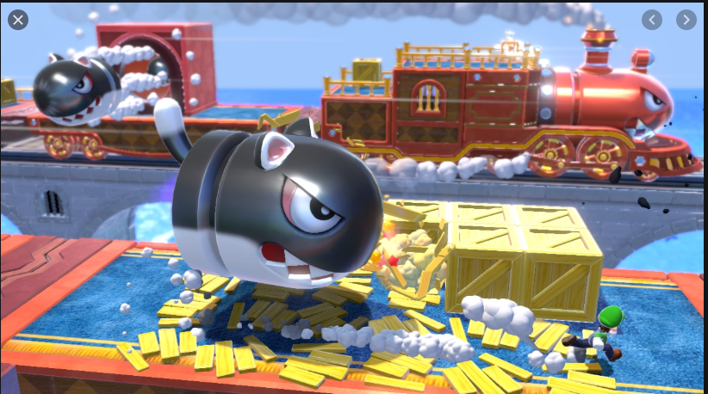
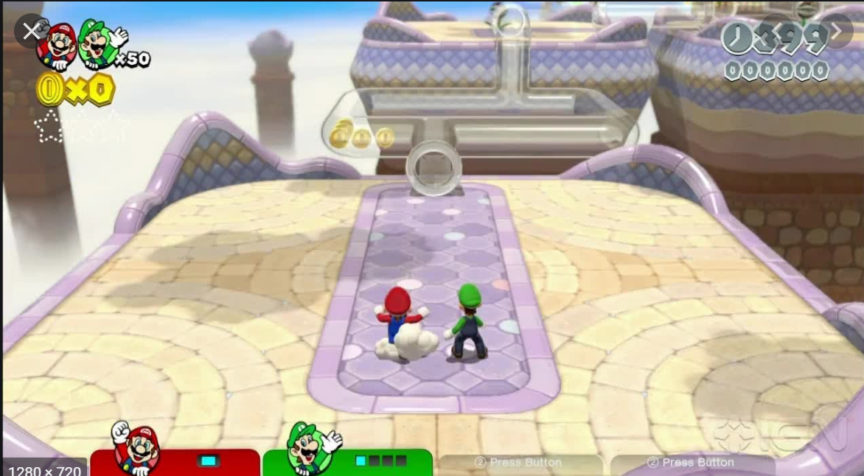
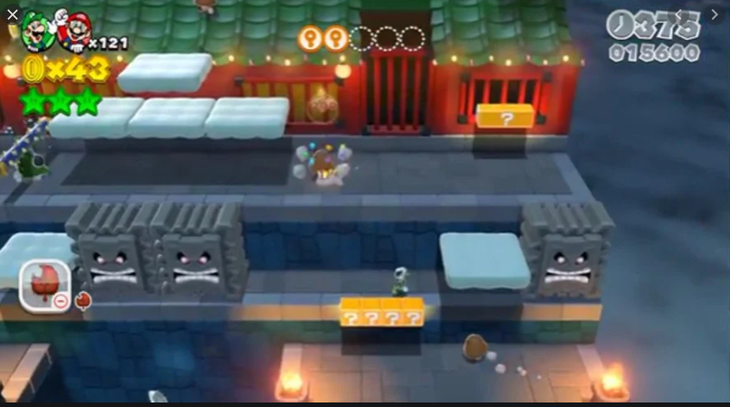
Pictures: Fixed Platforming examples

